Slide 1
Object Oriented Analysis
By PJ Davies
With Reference to:
  Real-Time UML by BP Douglass.
  ISBN 0-201-65784-8
©Paul Davies 2020. Not to be copied, used, or revised without explicit written permission from the copyright owner. This lecture may contain animations and is best viewed as a slide show

Slide 2
Review
In the previous lecture we discussed capturing user requirements in UML in the form of use cases (which is a more detailed version of Agile’s user stories.)
Use-case analysis attempts to capture and document the user-interactions taking place between the user and the system along with the benefits and effects on both.
Some example use cases for an ATM and a Library System are outlined again below.
  ATM
    Withdraw Money
    Check Balance
    Order Statement
  Library System
    Reserve a Book
    Borrow a Book
    Return a Book

Slide 3
Capturing these user interactions is crucial, as each use case defines or documents important functionality that we, as a software developer, will have to implement in our system.
The detailed analysis and design of our system from now on, will focus entirely on the implementation of software that :-
“Turns one (or more) use-cases
into a release of the
software to the customer.”

Slide 4
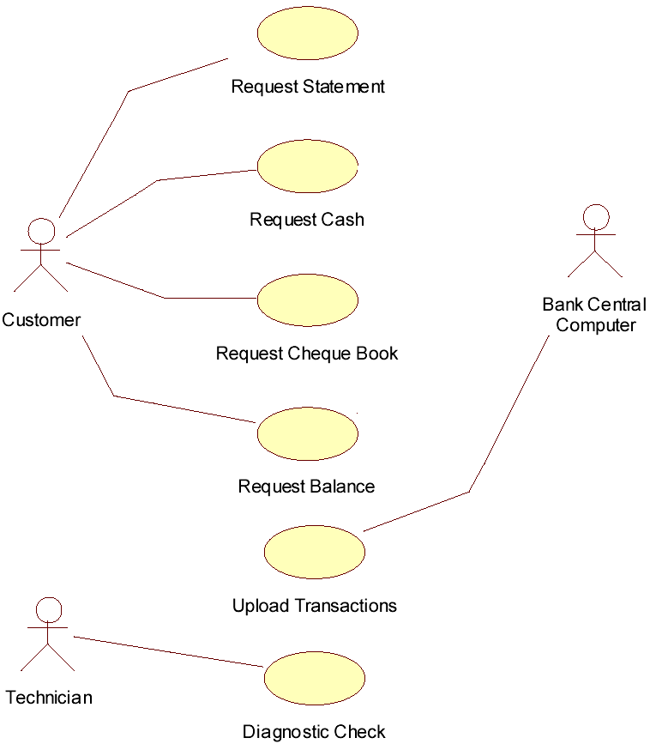
This illustration shows that process
Release 1
Withdraw Cash
Release 2
Release 3
The next step in the software development process is to identify the objects (and from there the classes) from which our system will be constructed and model their behaviour.

Slide 5
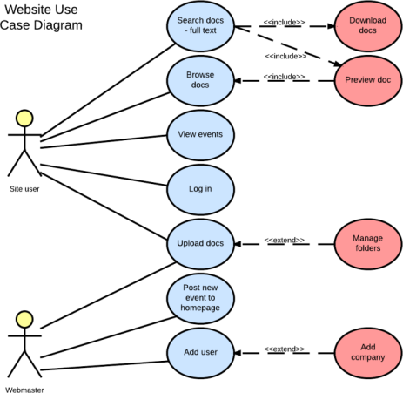
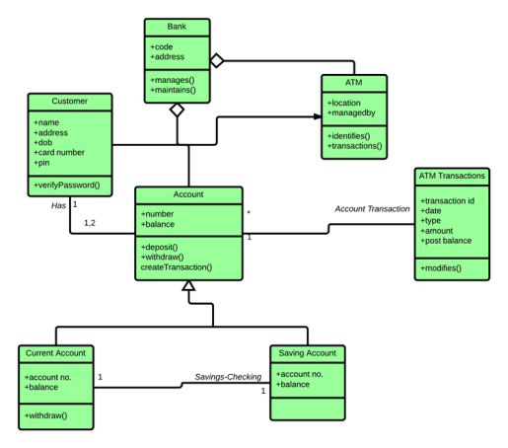
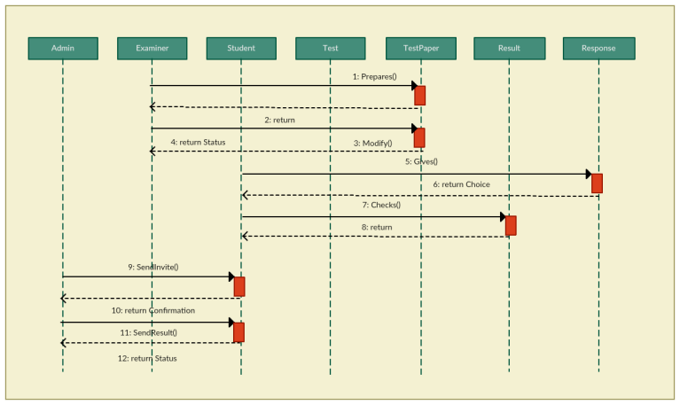
Use Case Diagram
Sprint
Pick and Implement a sub-set of Use-Cases
Step 2: Turn Sequence Diagram into an Architecture (Class Diagram)
Step 1: Identify Objects and Messages on a Sequence Diagram
Class Diagram
Sequence Diagram

Slide 6
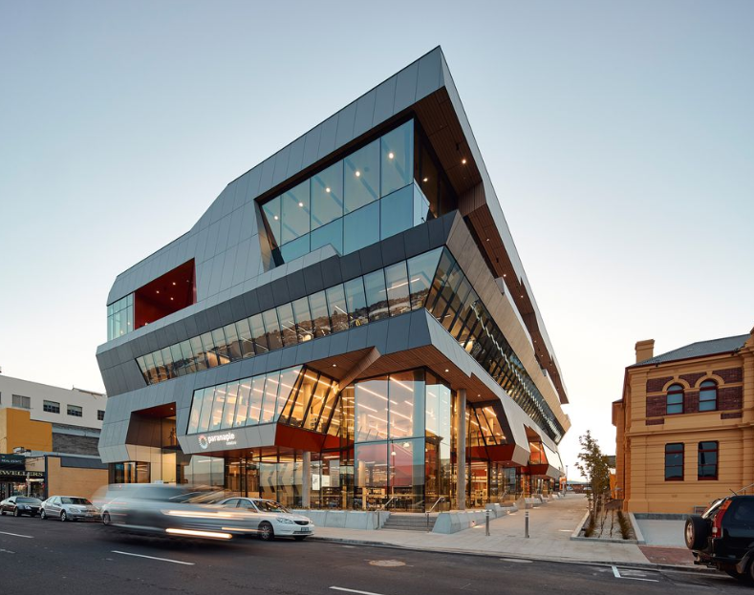
What is an Architecture?

Slide 7
Architecture describes the set of components (or objects) from which a complex system is composed. It captures their properties and their relationships and interactions with other objects.
  For example, a building is composed of floors, ceilings, windows, doors, stairs, lights, heating etc.
  A car is composed of engine, gearbox, wheels, doors, lights, seats etc.
  A computer is composed of CPU, Disk, Drive, Memory, mouse, keyboard etc.
Each of the above components has properties, e.g. colour, size, speed etc. and interacts with one or more other components in the system
Architecture functions as a blueprint for the design and build of system (like the architecture of a building or of a CPU). Once implemented architecture is fundamentally very difficult and costly to change, so it’s important to spend some time getting it right.

Slide 8
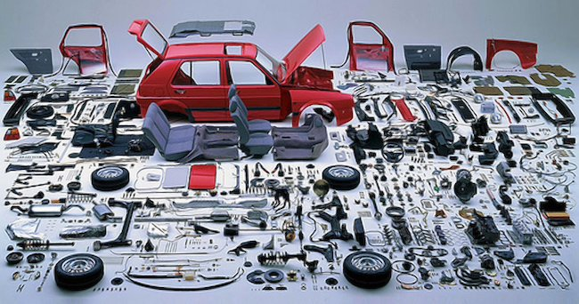
Software Architecture: Structural and Behavioural Modelling
By studying each use-case in turn, we attempt to identify an architecture or structure for our software, comprising a set of objects (and eventually classes) from which our system can be built.
This is the CREATIVE bit – We must identify and create the “things” (objects or components) that will be needed in our system and decide what each of them will DO and what other objects it collaborates with.

Slide 9
Homework Question
Think about something interesting that you have built, electronic, software, mechanical etc and specify what it was used for.
Now list the objects or things from which it was made and explain why you incorporated those things.
What role did each object play in achieving the functionality of the system?

Slide 10
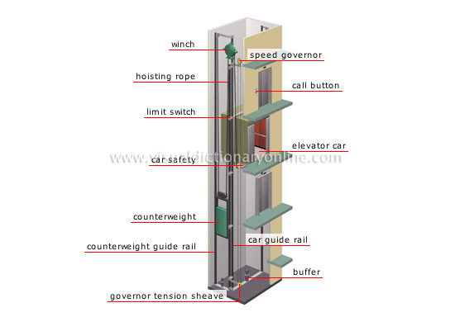
As an example, consider an Elevator architecture shown opposite.
Example User Story: “As a passenger I want to be able to enter an elevator and have it transport me to a new floor”
This architecture and the “objects” shown, were created as the means to implement that use-case
Each object plays a role in realising this story/use case (otherwise why is it there?) Some objects obviously communicate with others.
An architectural model thus shows a set of objects which collaborate to implement the requirements of the system (e.g. use case or user story).
Question: Think about the role and responsibility of each object shown here, what does each do?

Slide 11
Object Roles
and Responsibilities

Slide 12
What do we mean by an object's Roles & Responsibilities?
An object’s role tells us what the object does in the system.
An object’s responsibility (i.e. it’s obligation) is to carry out its role when requested by another object.
For example, consider an ATM
  The role of a printer is to print receipts and statements.
  The role of a bank central computer is to maintain account details and record transactions on those accounts.
  The role of a Card reader and Keypad is to identify the user for the rest of the software etc.
It is the collaboration of a set of objects, each with a role to play and working with other objects in the system that allows the system to implement the higher order behaviour defined by a use-case/user story.
We have to create the objects and give them roles to play in the system.

Slide 13
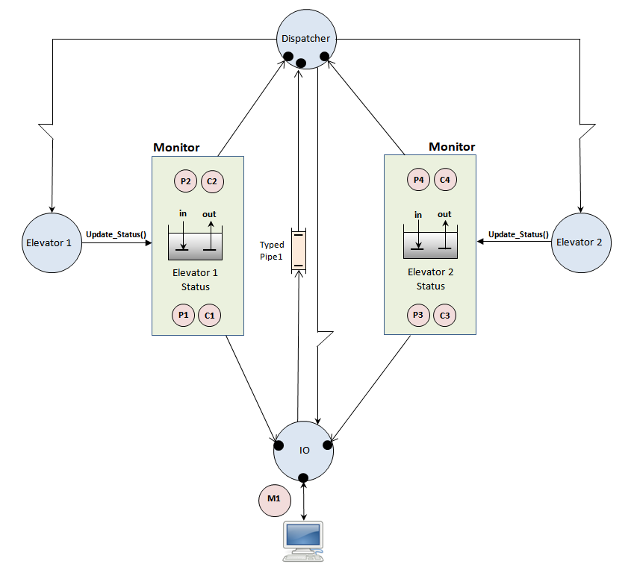
Problem 1: Think about your 1st assignment.
What were the objects from which your Elevator was constructed?
What roles and responsibilities did each object assume in the system?
Can you tell me what each object does, why it is here and the part it plays in realising a use-case/user story

Slide 14
Problem 2:
Which objects collaborated with others?
How was this collaboration achieved (what mechanism was used)?
How did this collaboration of objects lead to the realisation of a use-case/story that allows customers to travel between floors?

Slide 15
Object Oriented
Analysis (OOA)

Slide 16
OOA attempts to capture or build a model of the system that identifies
  The set of run time Objects from which the system will be built.
  The set of Classes from which those objects can be created.
  The Relationships between the objects/classes.
  The Multiplicities (how many of each exist)
  The Behaviour of those objects in terms of how they collaborate with each other (through a process of message passing) to implement the requirements of our use-cases.
This model is analogous to that used in designing say digital systems where we constructed an architecture composed of a set of objects (Flip-Flops, Counters, Nand gates etc.)
Each of those objects had behaviour specified by VHDL/Verilog code (analogous to the C++ class code) and were connected together (i.e. relationships between components) with wires through which signals and messages could be sent to allow circuits to communicate.
Together those objects and their communication allowed a complex system to be built out of smaller components with each contributing to the overall behaviour of the system.

Slide 17
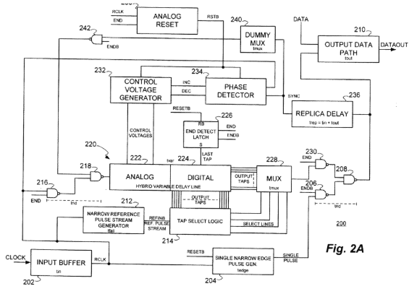
Architecture of an Electronic Circuit: Objects + Collaborations + Wires + Messages

Slide 18
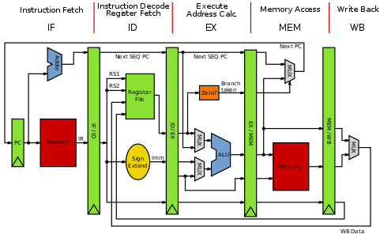
CPU Architecture: Objects + Collaborations + Wires + Messages

Slide 19
Assignment 1 Software Architecture: Objects + Collaborations + Messages

Slide 20
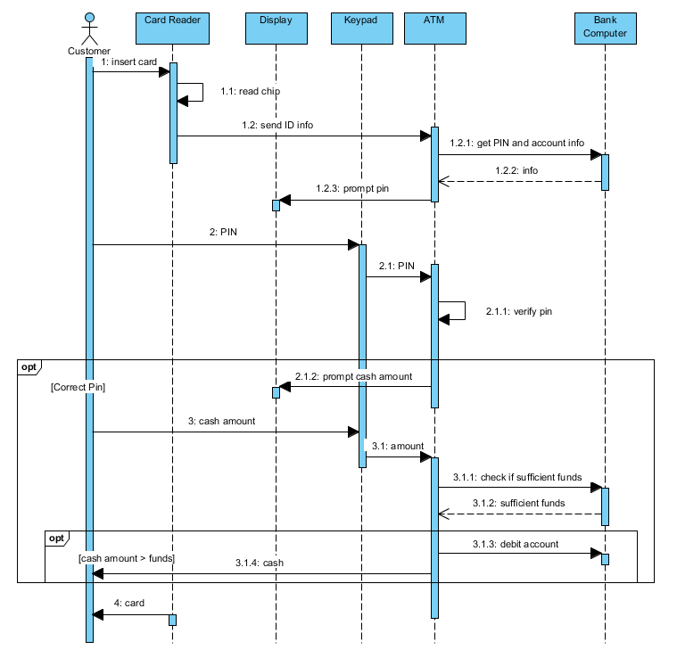
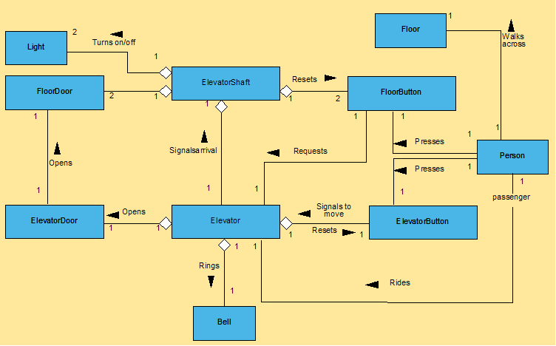
Capturing the Software Structure/Architecture in UML
Objects and their Messages are captured in a Sequence diagram
Classes and their Relationships are captured in a Class diagram
Sequence diagram for ATM
Class diagram for an example real Elevator

Slide 21
Where do we start when all we have is a Use-Case description?

Slide 22
Creating the Structural Model –
Step 1 - Identify the Run-Time Objects
First and foremost we have to create/come up with/invent the run-time objects from which our system will be composed.
For example, we know that
  Cars are composed of an engine, gearbox and 4 wheels.
  Computers are composed from one or more CPUs, memory chips, motherboards, and disks.
  Buildings are composed from walls, floors, doors, ceilings.
  Elevator simulations are composed from elevators, semaphores, pipelines, and data pool objects.
  Gas stations have pumps and credit card readers etc.

Slide 23
Step 2 - Delegate Roles and Responsibilities to our Objects
  Having identified objects, we delegate roles/responsibility to them
  In other words, for each object you identify, ask the question
    What will you do in the system (what is your role)?
    What is expected of you by others (your responsibilities)?
  In other words justify the objects inclusion in the architecture, if you can't then it shouldn't be there?
Example Object: A Linked List
  Role: My job is to store and retrieve data on behalf of others.
  Responsibilities: I will take care of performing the following tasks when asked by other objects in the system.
    Insert Data,
    Delete Data,
    Find Data etc.

Slide 24
  Roles and Responsibilities: Mapping to Member functions
  An object’s roles and responsibilities will eventually be represented by member functions of the classes from which each object is created.
  Other objects can then invoke those member functions to request the object to carry out some or all of it’s roles and responsibilities within the system.
  Consider your 1st Assignment.
    What was the role of each object in your architecture?
    What were its responsibilities?
    How did each object realise it’s responsibilities in terms of member functions?

Slide 25
Consider the Monitor:
What was its role and responsibility in the system?
What member functions existed for the Monitor?

Slide 26
Step 3 - Identify Object Data
Once object responsibilities have been identified, ask each object
    What data will you need to carry out your role?
  Object data is captured by member variables within the object and thus is defined within the classes that implement the objects.
Question: What data did the objects in your 1st assignment store?
  Object data is often uncovered naturally as a result of discussing and implementing the object’s roles and responsibilities. E.g. I am an elevator. I need to store this information in order to carry out my role in the system:-
    Status: In or out of service
    Doors Status: open or closed
    Current Floor Number
    Direction of travel
    Pending requests

Slide 27
Step 4 - Identify Relationships with Other Objects
Objects in a system do not work in isolation, they communicate (collaborate) with other objects to achieve high level functionality, therefore relationships exist between certain objects in the system.
A structural model attempts to capture those Relationships.
Capturing relationships concerns itself mostly with identifying which objects communicate/collaborate with other objects in a system.
For example there are collaborations between
  A Throttle sending messages to an Engine Management System.
  The Reset Button that sends a message to the Motherboard and the motherboard which sends a reset message to the CPU.
  An Elevator button that sends a floor request message to an Elevator Controller.

Slide 28
Capturing the objects and their collaborations are essential for the realisation of a use-case.
What objects exist here?
What collaborations exist and why?
Why does the dispatcher communicate with both elevators?
Why do the elevators not communicate with each other?
What drives these design decisions?
Answering all the above allows you to build a system to implement a use-case.
Elevator Simulation

Slide 29
Step 5 - Identify Relationship Types between Objects
Example 1: Using relationship
  Do objects simply collaborate or work with each other? This implies an association between those objects in the code, in much the same way that a CPU uses a disk drive and sends messages to it, likewise, an Elevator uses Datapools, and Semaphores.
Example 2: Ownership or “part of” relationship
  Does one object own another (implying encapsulation or aggregation in the code) in the same way that a Car ‘has’ or ‘owns’ and a monitor owns a datapool and semaphores.
Example 3: Kind-of or “is a” relationship
  Are objects related by classification, i.e. is one object a kind-of another, implying some form of inheritance, in the same way that Pentiums III’s and Pentium IV’s are ‘kinds-of’ Intel processor which in turn are ‘kinds-of’ CPUs.

Slide 30
Step 6 - Identify Object Multiplicities in those relationship
Wherever there is a relationship, we also have a relationship multiplicity.
Multiplicity defines how many objects of some type exist in that relationship.
For example,
  How many floors does a skyscraper have?
  How many bulbs does a lamp have
  How many seats does a Ford Explorer have?
  How many PCI slots does our Motherboard have?
  How many students can enroll on a course?
  How many courses exist within a program?
  How many instructors deliver a course?
  How many faculty exist within a dept?
  How many elevators does a dispatcher communicate with?
  How many objects access a data pool?
  How many data elements can we store in a linked list ?

Slide 31
How do you know if you have the correct Architecture to start coding?
Simple. Your architecture will be correct when you can identify how your set of objects, each with their own responsibilities, can collaborate together through the process of message passing, to implement the requirements of your use-cases.
For example, start with each use-case description/scenario in turn. Now try to identify how that step-by-step sequence of operations maps to a set of messages passing back and fore between objects. There are no right or wrong solutions here, although some solutions may be better than others. This is the creative side of software design.
If you have done it correctly, you should be able to traverse your use-case from start to finish and identify a sequence of messages (leading to functionality) passing between the objects in your system that make it happen.
If you end up in a position where you cannot see how some functionality within your use-case can be implemented using the objects that you currently have, then you need more objects, or the objects need more responsibilities (they have to do more things)!!!

